Slide 1
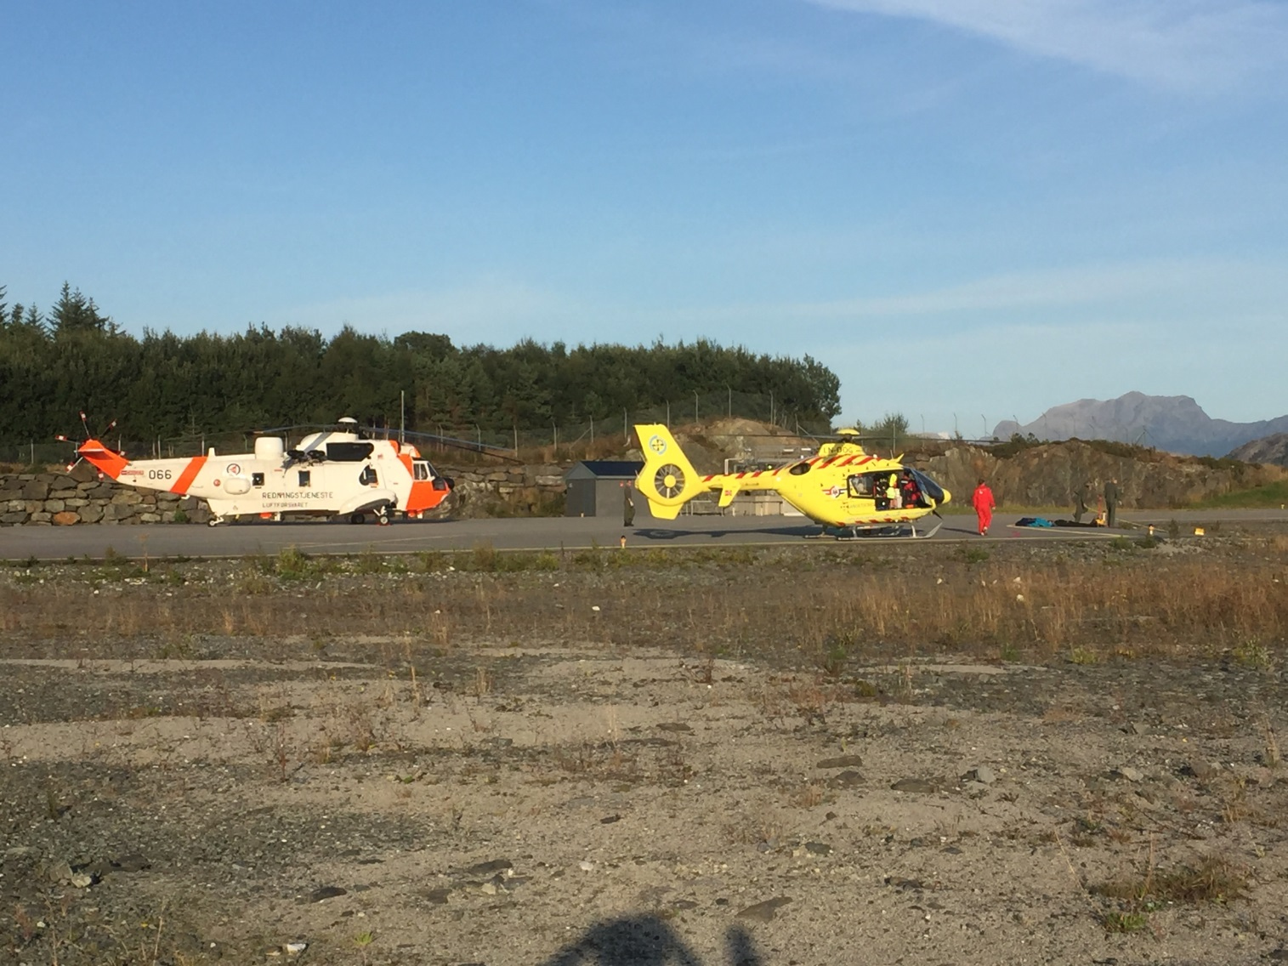
Base rig vs. helicopter -a simple study in Norway.
Sea King
8500kg
EC 135 P2+
2600 kg

Slide 2
Base rig vs. helicopter downwash -a simple study

Slide 3
Jumps from Kjerag ( 51087)

Slide 4
Statistics Kjerag

Slide 5
Watch Slide 5 Video Here

Slide 6
Base rig vs. helicopter -a simple study
 | Sea King | EC 135
400 feet | 1min 40 sec Moved 15 m. | 4 min 30 sec Moved 5 m
300 feet | 60 sec Sudden move | 2 min 30 sec Sudden move 15m
200 feet | 20 sec Sudden move | 45 sec Sudden move > 15 m
120 feet | 6-8 sec, Tight rope | 15 sec Tight rope (flying)

Slide 7
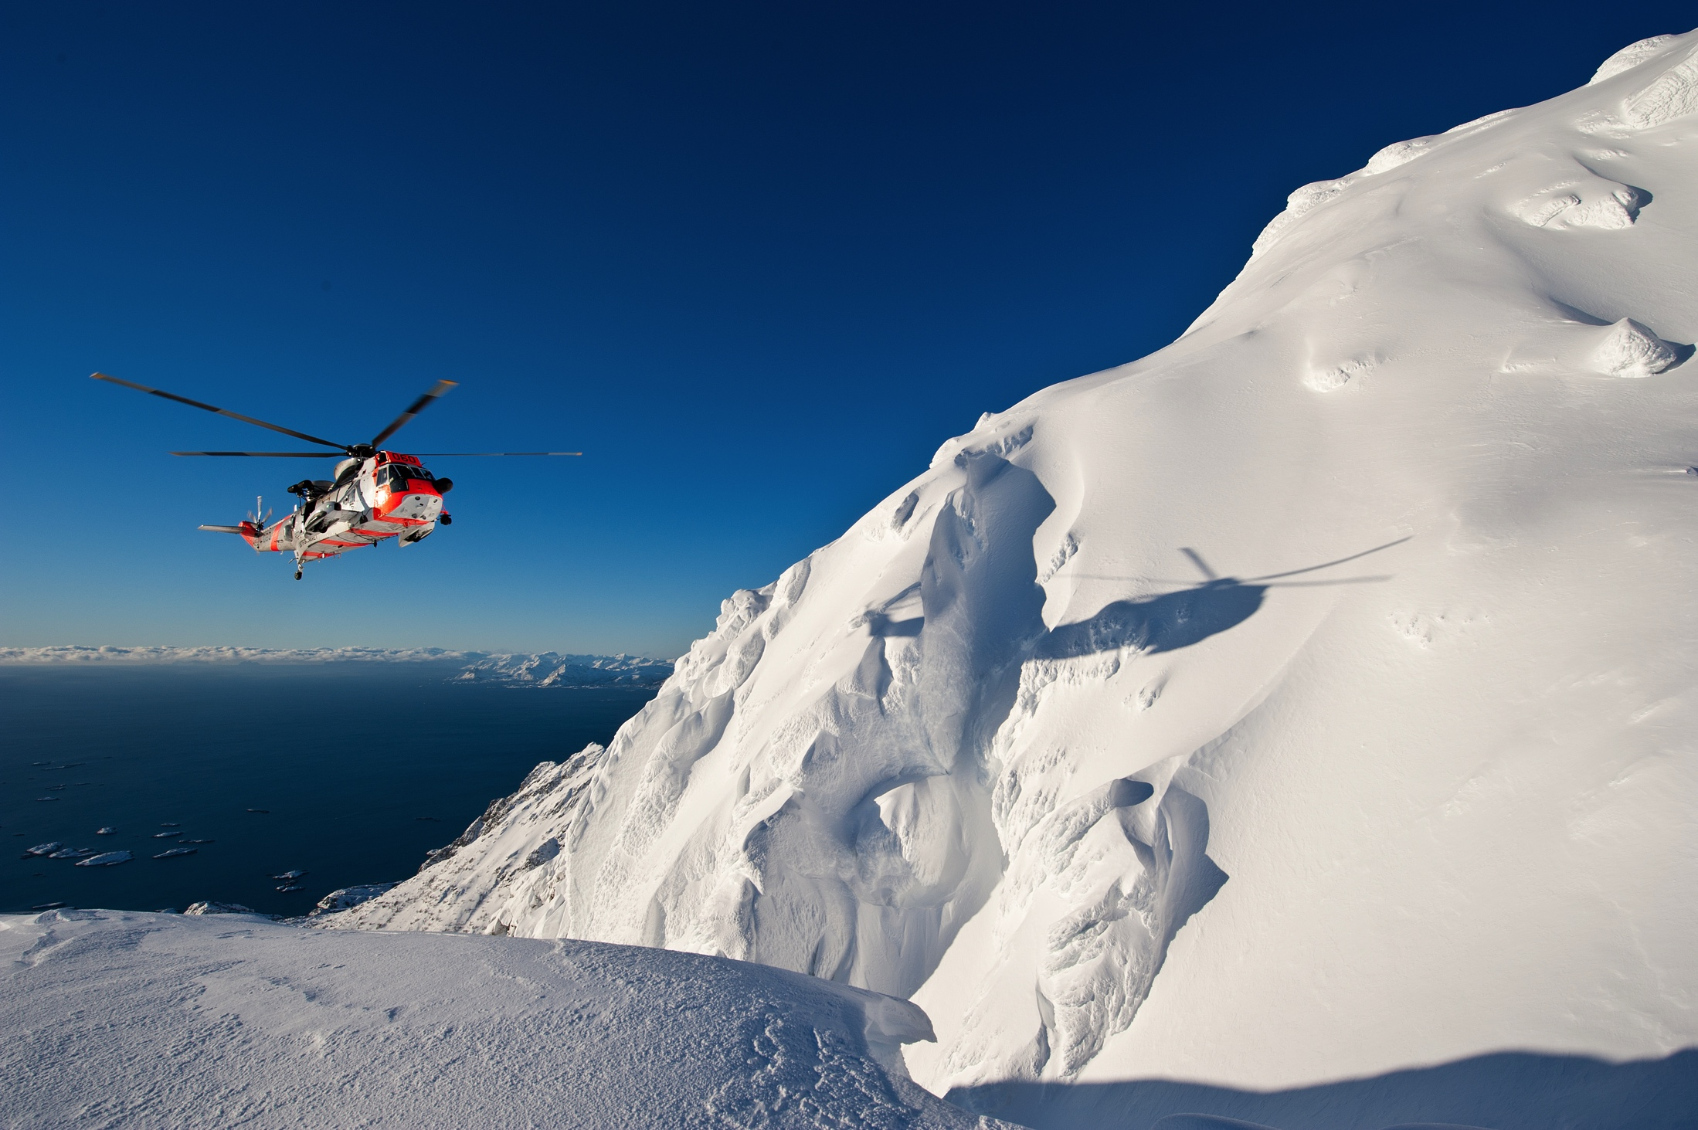
Thanks for your attention !
Fredrik Jomaas, Major, CO 330 sqn

